Slide 1
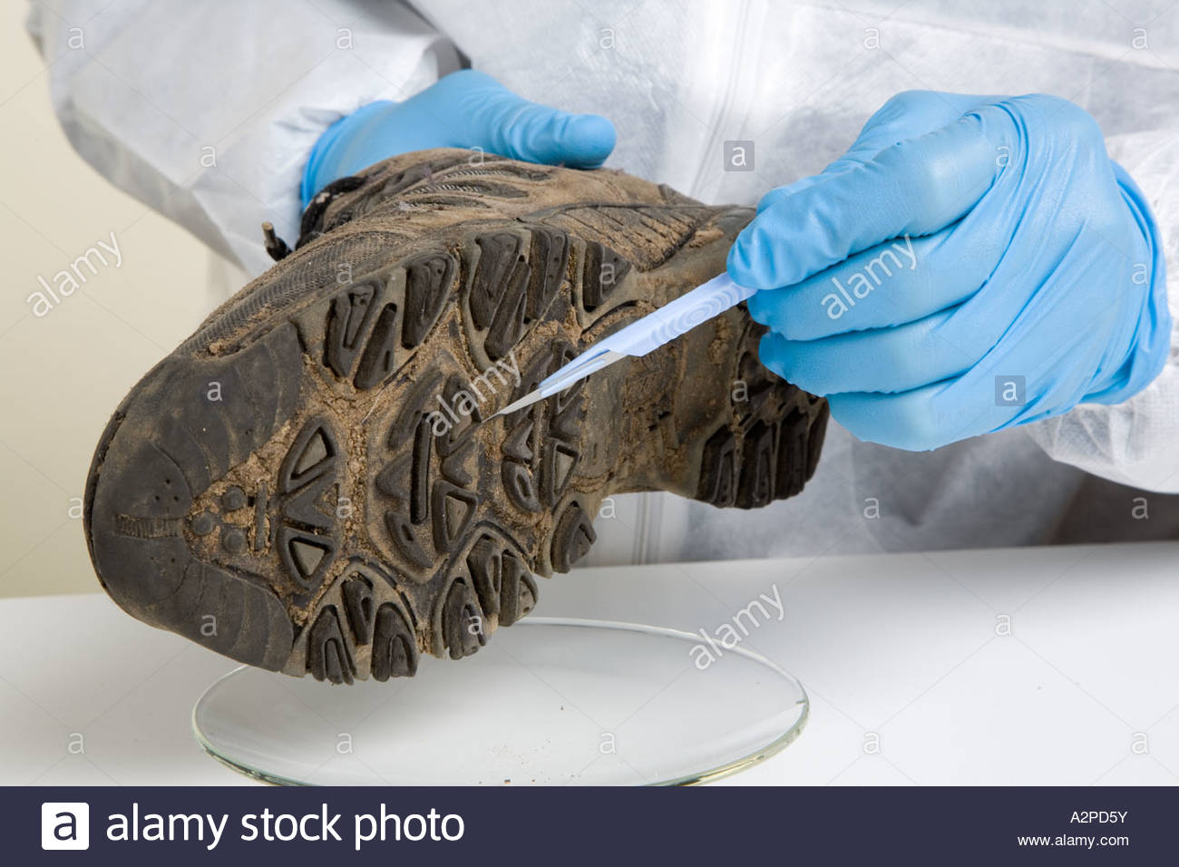
Soil Evidence
Chapter 12

Slide 2
Introduction
Soil is produced by a complicated process, influenced by these factors
Temperature
Rainfall
Chemicals
Minerals
Soil from different locations can have different physical & chemical characteristics

Slide 3
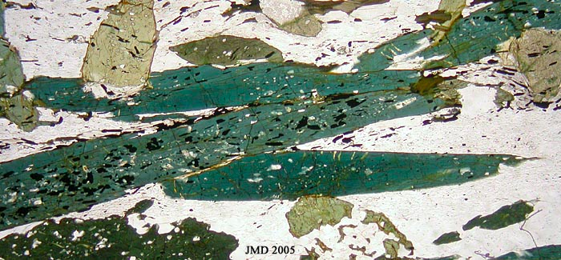
History of Forensic Soil Examination
Around since the late 1800’s
1893 – Dr. Hans Gross (Austrian) – applied science to criminal investigation, including analyzing soil
Georg Popp (German) – 1st forensic scientist to use soil evidence to solve a crime
During a murder investigation, he analyzed a soiled handkerchief left at the scene & found bits of coal & hornblende particles (a greenish black mineral). Deduced the suspect worked in a coal mine & gravel pit containing hornblende.

Slide 4
Soil Composition
Soil – part of the top layer of the Earth’s crust where most plants grow
Contains minerals (naturally occurring crystals), decaying organisms, water, and air in varying amounts
Soil texture – describes the size of mineral particles that make up the soil (3 main soil grain sizes)

Slide 5
Soil Texture – Grain Sizes
Sand – largest grain size. Granules of fine rock particles
Silt – medium grain size. A mixture of minerals, water, gases, & remains of dead organisms
Clay – smallest grain size. Has the capacity to absorb & hold water.

Slide 6
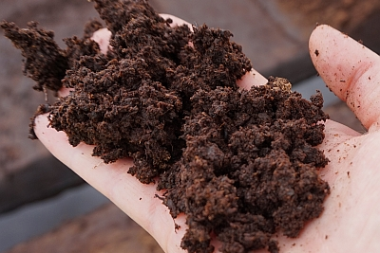
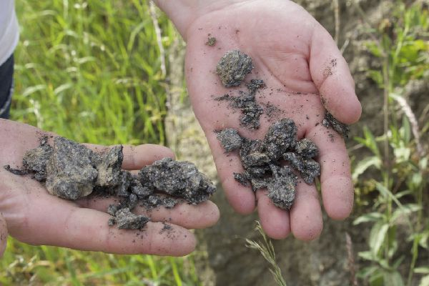
3 Subcategories of soil
Loam – type of soil made up of sand, silt, & clay
Peat – soil with more than 20% decaying organic material (animal or plant)
Chalk – alkaline or basic soil, contains various sized pieces of a solid, but soft rock called chalk
Loam
Peat
Chalk

Slide 8
Soil Profile
Soil forms in horizons or layers
O horizon – called humus
A horizon – called topsoil, dark in color, where seeds sprout & plants grow
E horizon – light in color, made of sand & silt. H₂O moving thru removes minerals – leaching
B horizon – called subsoil, clay & mineral deposits form above
C horizon – has partially broken up rocks, very little humus. Roots cannot grow
R horizon – solid rock layer

Slide 9
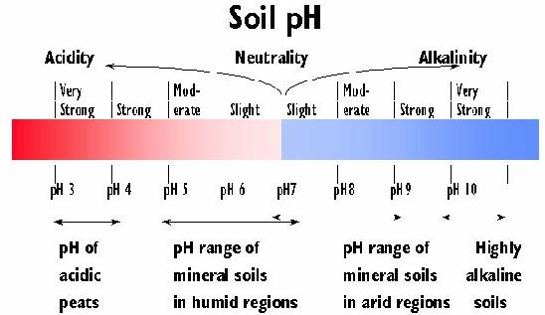
Chemistry of Soil
pH – is the soil
Acidic pH = 0 – 6.9, basic (alkaline) pH = 7.1 -14, or neutral (pH = 7)

Slide 10
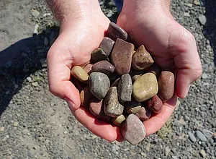
Sand
Sand – formed by wind & water acting on rocks, called weathering
Contains only 1 minerals – called a crystal
Contains 2 or more minerals – called a fragment
Can be anywhere from 0.05 mm to 2 mm in diameter
Can be round or angular
Rounding – as pieces of rock are moved by wind or water, they hit each other and can smooth each other out

Slide 11
Different types of sand

Slide 12
Mineral Composition of Sand
Sand from different locations contains different combinations of minerals
4 types of sand

Slide 13
Continental Sand
Contains mostly quartz, micas, feldspar, and dark colored minerals like hornblende or magnetite
Feldspar present? Came from a temperate/polar environment
High % of quartz? Sand is very old

Slide 14
Continental Sand
Quartz sand – white sand
Feldspar sand – orange specks are feldspar

Slide 15
Continental Sand
Mica sand – has dark streaks
Dark Mineral sand

Slide 16
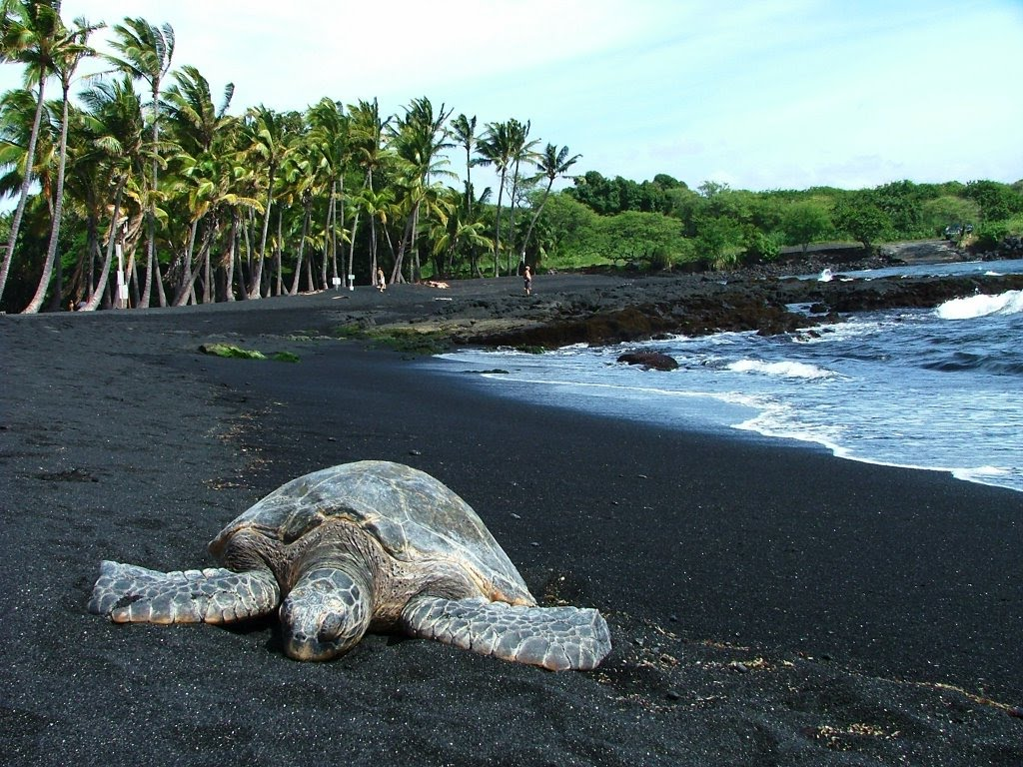
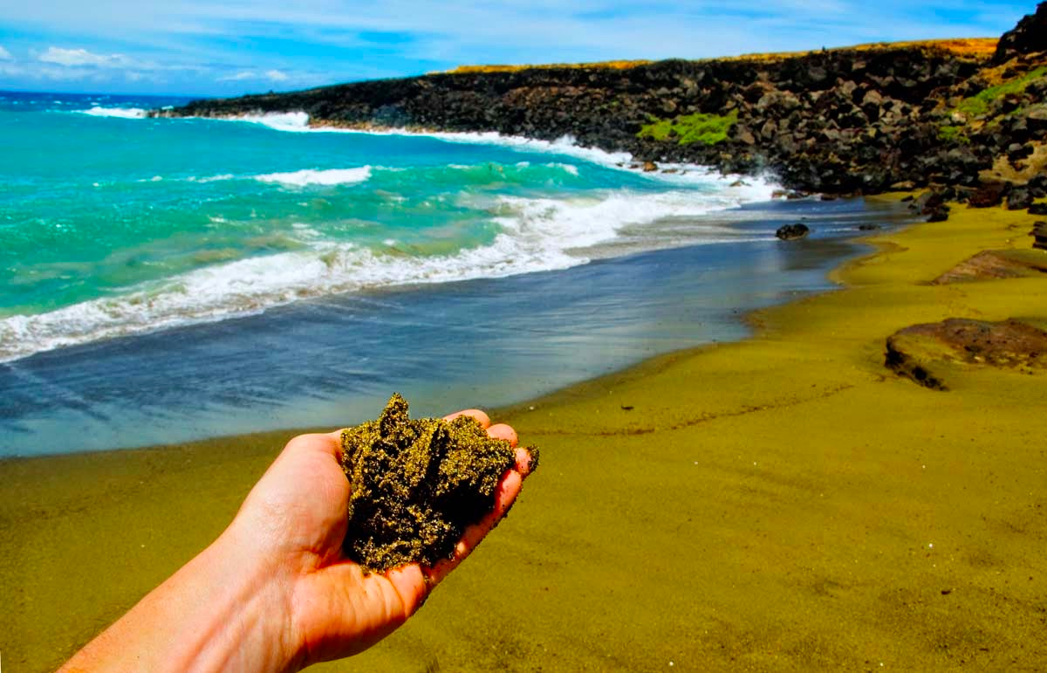
Volcanic Sand
Usually dark in color due to the presence of black basalt or green olivine
Comes from mid – ocean volcanoes
Hawaii
Guam

Slide 17
Skeletal (Biogenic) Sand
Made of the remains of marine organisms, such as microorganisms, shells, and coral
Younger than other types of sand
Originates in water
Contains high amounts of calcium carbonate (CaCO₃)
If it contains coral – sand is from a tropical location

Slide 18
Skeletal (Biogenic) Sand

Slide 19
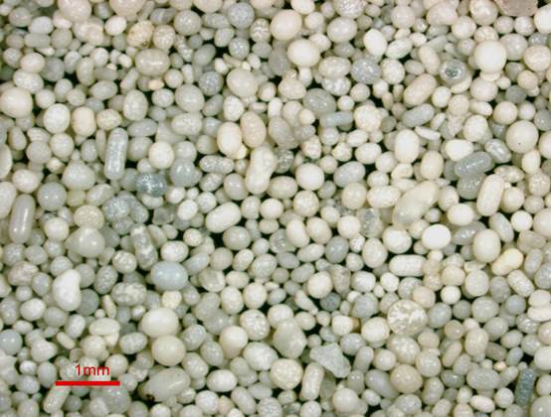
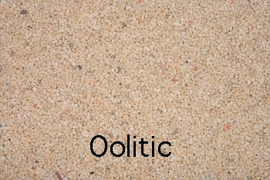
Precipitate Sand
When dissolved minerals settle as water evaporates.
Form oolites – small round structures

Slide 20
Soil Collection
1. Collect all samples asap before the environment can be changed by nature, animals, or humans.
2. Collect at the surface baseline samples & samples that appear different or out of place from the rest of the environment.
3. Collect at least 4 tablespoons of material from several locations at the scene.
4. Sketch the crime scene & note on the map where the samples were taken.
5. Be careful not to remove soil stuck to shoes, clothing, or tools found at the crime scene & package them separately.
6. Carefully remove soil from vehicles& package those samples separately.
7. Document all samples by taking photographs, drawing sketches, & labeling the evidence containers.
8. Collect additional soil samples from the 4 compass points (N, S, E, & W) within a few feet of the crime scene. Collect another set 20 – 25 feet from the crime scene.

Slide 21
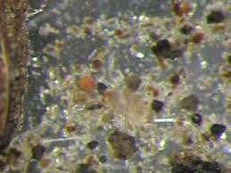
Forensic Analysis of Soil
Low Power microscopic examination reveals plant & animal materials.
High Power microscopic examination allows id of minerals & rocks

Slide 22
Density Column (density-gradient tube)
A glass tube filled from bottom to top with liquids of lighter and lighter densities, used to determine the density distribution of soil
Can also be done with water and a soil sample

